Slide 1
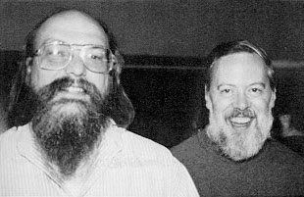
UNIX (History)
Originated as a research project at A T & T Bell Labs in 1969 by Ken Thompson and Dennis Ritchie.
Developed in several different versions for various hardware platforms (Sun Sparc, Power PC, Motorola, HP RISC Processors).

Slide 2
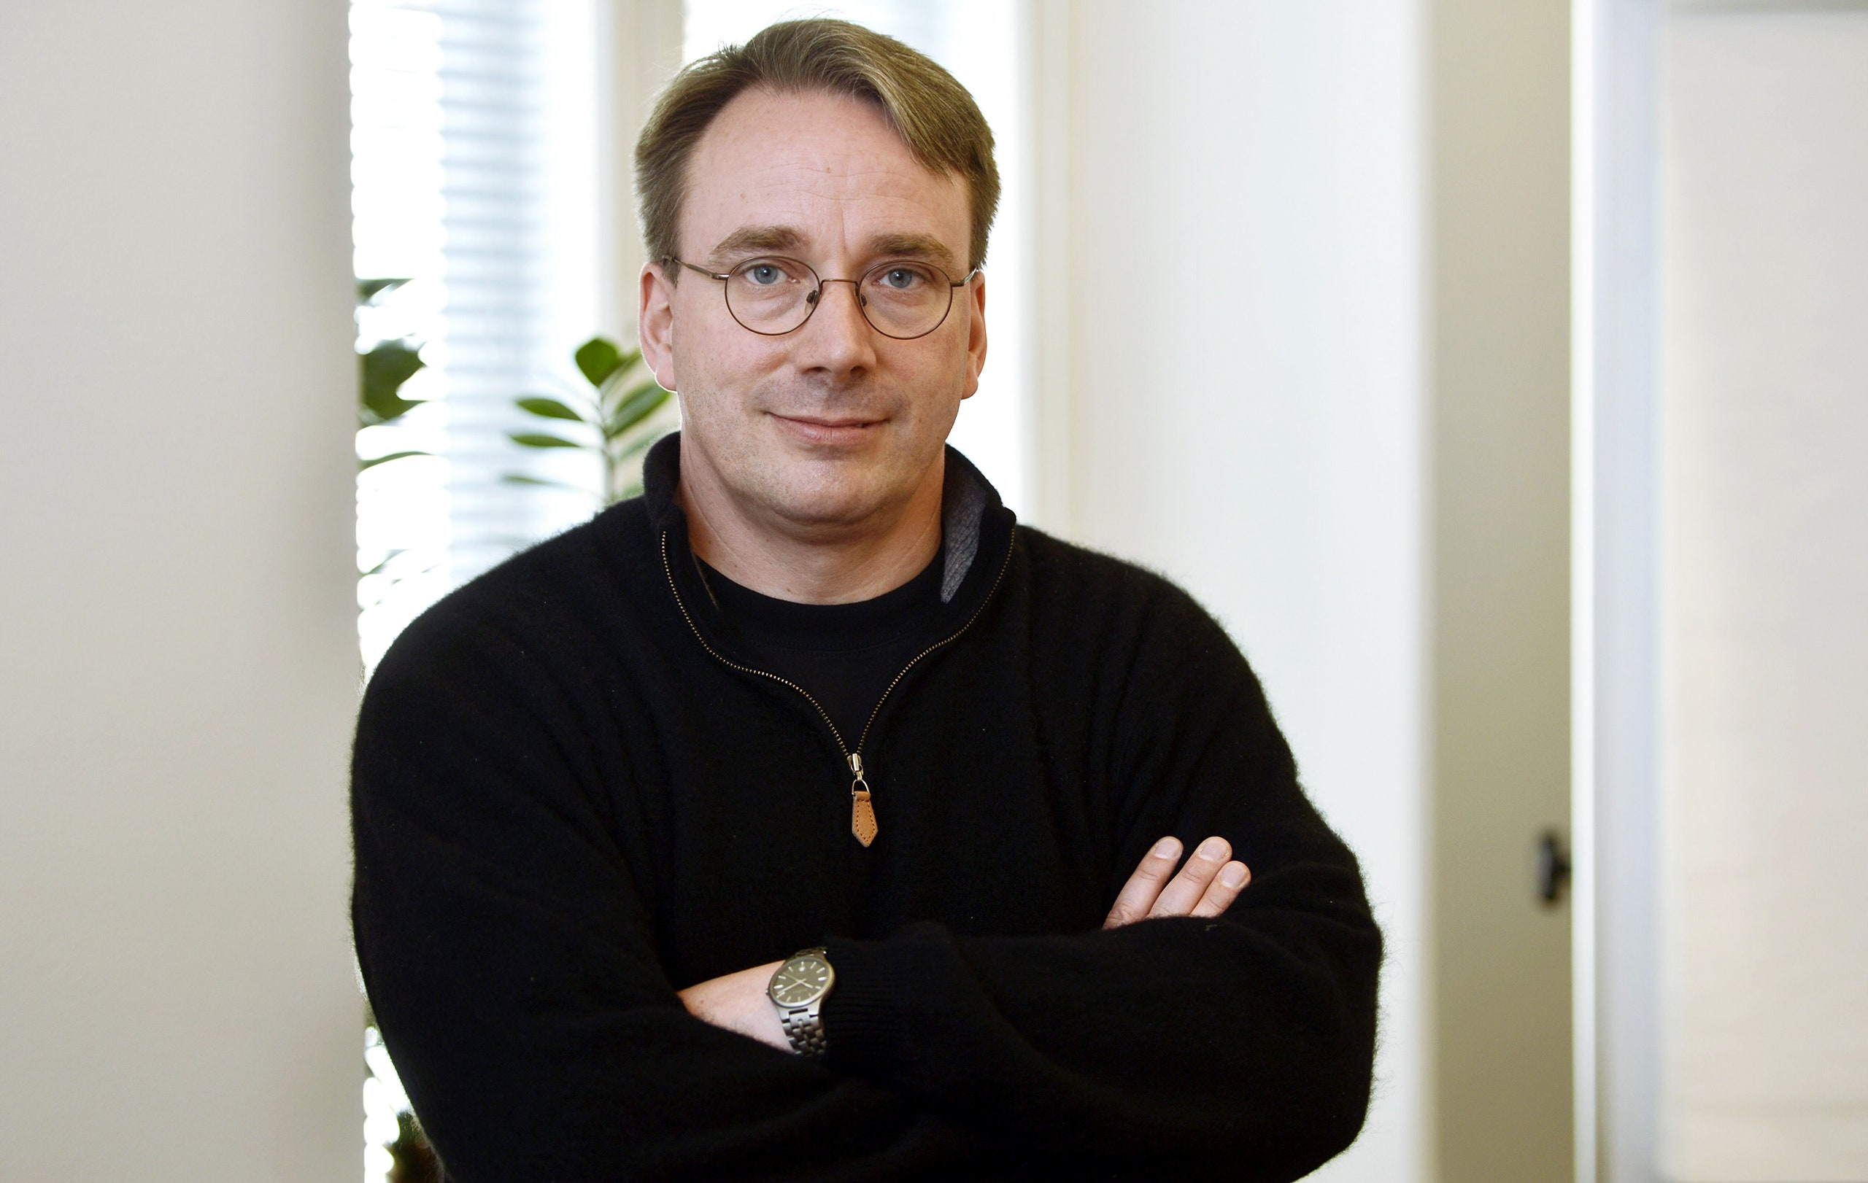
UNIX (History)
In 1991, Linus Torvalds created a UNIX-like system to run on the Intel 386 processor.
While still a student at the University of Helsinki, Torvalds started developing Linux to create a system similar to MINIX, a UNIX operating system.

Slide 3
UNIX (History)
Intel had already started dominating the PC market, but UNIX was nearly absent from the initial Intel market.
In January 2000, Apple announced MAC OS X, a UNIX/Mach hybrid that provides UNIX command line features.

Slide 4
Is Linux Same as UNIX?
YES, Because:
It has essentially the same look and feel like any UNIX operating System.
It offers the ability to run nearly any program that runs on UNIX systems (through API conventions such as POSIX, etc..).
NO, Because:
The heart of the system (kernel) has a lot of new features that go beyond the classical design philosophy of UNIX kernels.
Therefore Linux is UNIX Like Operating System, but not UNIX.

Slide 5
What is GNU?
GNU stands for “GNU's Not Unix”. GNU emphasizes a major project of the Free Software Foundation (FSF) that really created the LINUX operating system with many of its popular tools.
Richard Stallman created FSF, in order to encourage the development and use of freely redistributable code.
Freely means the freedom of redistributing your code under certain conditions. It does NOT mean zero financial cost!
The GNU Public License (GPL) defines the terms and conditions of redistributing the LINUX kernel and other tools that make it usable, forming a LINUX distribution.

Slide 6
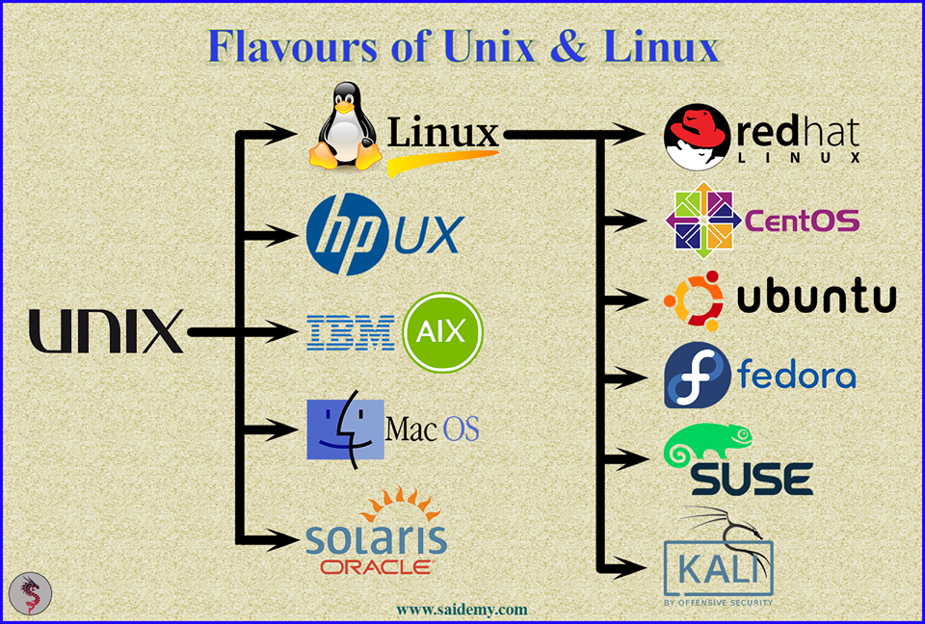
Flavours of UNIX

Slide 7
Features of Linux
High Security (Virus Free)
High Stability
Ease of Maintenance
Hardware Independent
Freely Available
Distributed OS
Supports All File Systems
Multiuser, Multitasking OS
Open Source
Ease of Use
Customization
Education
Support
Better Process Handling

Slide 8
Linux is Used in:
Super Computers
Servers, Cloud Computing
The Large Hadron Collider
NASA
Space Robots
Game Consoles
Smart TVs
US Defence
Nuclear Submarines
Space Station
Smart Watches
In-Car Entertainment
Flights
Smart Cars & Bikes
Air Traffic Control (ATC)
Stock Exchanges
Mobile Phones
Laptop, Desktops & PCs

Slide 9
Linux Kernel
The operating system is broken into three pieces: the kernel, the shell, and the built-in utilities. The kernel is responsible for low level hardware communication, the shell provides human users with a user-friendly interface, and the built-in utilities provide basic tools for doing work.
Shell
Kernel
Hardware

Slide 10
UNIX/Linux Shell
Provides a powerful interface to the UNIX Operating System, so you can manipulate data and execute several applications under certain conditions.
Also known as the 'command-line' interface, a bit like the old “Command Prompt” in Windows/DOS systems, but it is not the same.
Comes under different flavours, but all of them do the same thing in slightly different ways.
Knowing the shell well is the ONLY WAY to make the most out of a UNIX system. It can be a bit difficult at the beginning, but since you get used to it, you have made a good friend that will help you address every computational problem!

Slide 11
Logging Into The Shell
to use the UNIX shell, you will have to authenticate yourself (tell the system who you are). This process is commonly called the 'login' process, and it involves two steps.
Know your username and a password.
Have a means of communicating with the UNIX shell, so you can provide this kind of information.
The first step is quite easy. You contact your system administrator or relevant authority and you obtain a login name and a password for the system. The second step requires a little bit more attention.

Slide 12
Linux Booting Process
POST
Power On Self Test
Basic Input Output System
Master Boot Record
Initram File System
Grand Unified Boot Loader
Kernel
Initialization
BIOS
MBR
InitramFS
GRUB
KERNEL
INIT

Slide 13
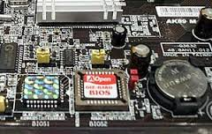
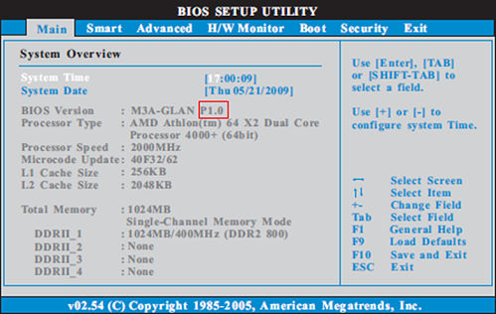
Linux Booting Process
Basic Input Output System (BIOS)
BIOS is a combination of both hardware as well as software.
BIOS provides us option to choose a boot device.
Then it gives the control to MBR (Master Boot Record).

Slide 14
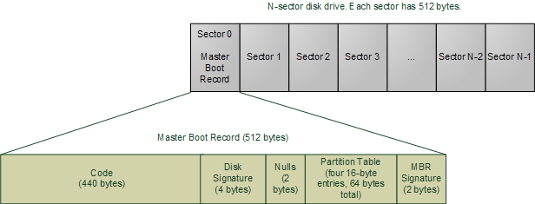
Linux Booting Process
Master Boot Record (MBR)
Provides us a boot selection menu to choose a particular Operating System (OS) with which we want to boot our machine.
It contains the information about the boot loader.
Then it handovers the control to the boot loader.

Slide 15
Linux Booting Process
GRUB (Grand Unified Bootloader)
GRUB is a file located in the address /boot/grub/grub.conf
The Older version of Linux Bootloader is LiLo (Linux Loader).
The latest version of Linux Bootloader is GRUB2.
It contains information about Linux Kernel & initial (basic) Ram Disk.
It also contains information about the particular partition in which the root file system is loaded.
Then it gives control to the Kernel.

Slide 16
Linux Booting Process
KERNEL
The name of the Linux Kernel is VM-Linuz.
It interacts between machine hardware and shell.
After getting control from the GRUB, KERNEL loads its splash image first with the help of initramfs, files which are accessed even without mounting the HDD.
Then it transfers the control to the INIT.

Slide 17
Linux Booting Process
INIT (Initialization)
INIT is the first process of Linux OS.
INIT is also known as the parent of all processes.
The process ID of INIT process is 1.
After loading itself then it loads the whole Operating System (OS).
There are several run levels in Linux which works on INIT values.

Slide 18
Linux Booting Process
Linux Run Levels
Run Level 0 = INIT 0 ➔ Shut Down
Run Level 1 = INIT 1 ➔ Single User Mode Without GUI & NFS
Run Level 2 = INIT 2 ➔ Multi User Mode Without Network FS
Run Level 3 = INIT 3 ➔ Multi User Mode with NFS
Run Level 4 = INIT 4 ➔ Research Purpose
Run Level 5 = INIT 5 ➔ X11 (Linux Graphics)
Run Level 6 = INIT 6 ➔ Reboot

Slide 19
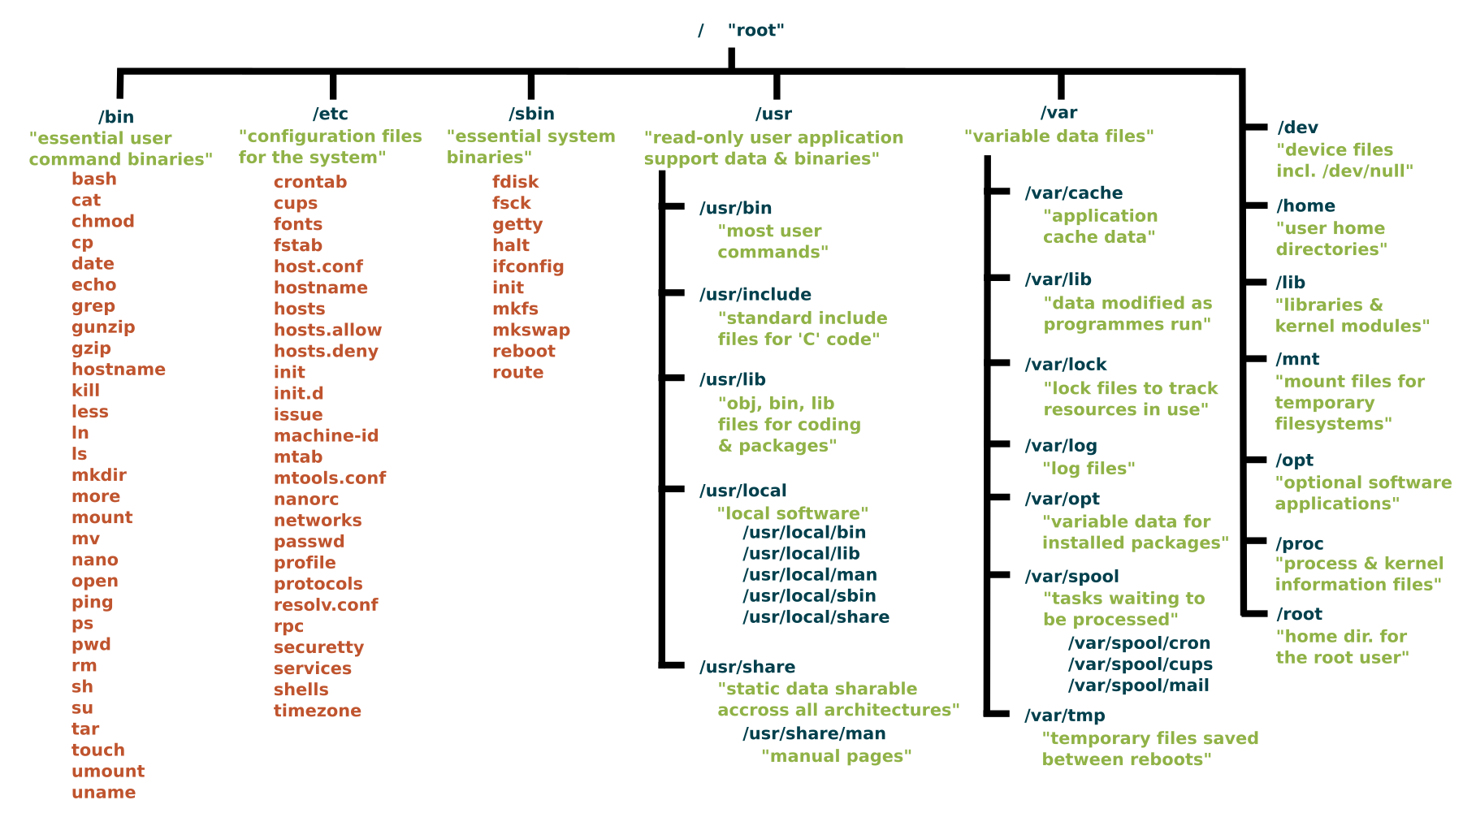
Linux File System Structure

